Slide 1

Calculator GUI Application
User Friendly way to Handel different calculation
By : Darshika Dudhat
Email – darshikadankhara@gmail.com

Slide 2
Introduction
Goal – Calculator GUI is mainly used for user friendly approach to do mathematic calculation, which are effectively do users expressions.
Motivation – To learn different libraries and modules , which help us in do better programming.

Slide 3
Technology Stack
Programming Language
Libraries
Development Tools
Python
Tkinter sympy
VS Code Git Hub
(Version Control)

Slide 4
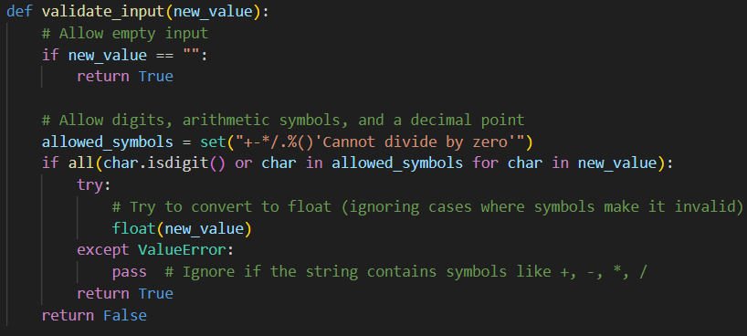
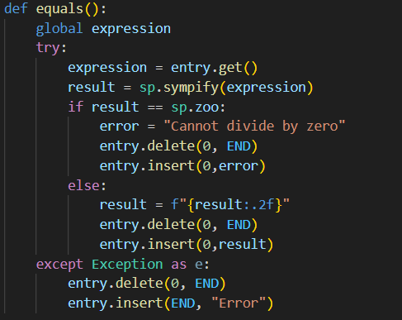
Code Snippet:
This function has validated the input the user pass, and deny the input if user type any invalid button like any character, or symbol except given in the calculator.
This function use sympy library.
It is more secure than eval() method.
It does not have access to the system, so it is more secure.

Slide 5
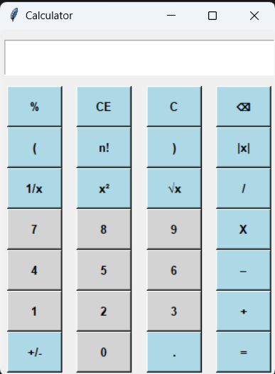
First look..
Calculator made by tkinter library in python.
It includes sympy library for the evalution of the expression.

Slide 6
Architecture:
User Interface (UI)
Core Logic
Exception Handling

Slide 7
Implementation:
Using Python Programming:
Very Powerful Tool for programming, and UI based Implementation
Code is shown as per Vs Code.
Challenges Faced:
How to validate the textbox that user can only input numbers.
Implementation of the brackets ().
Solution Implemented:
Regular Expression
Error Handling

Slide 8
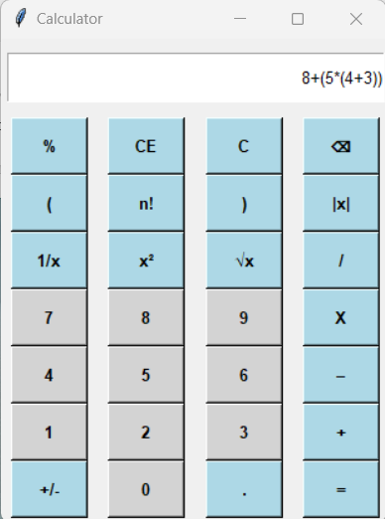
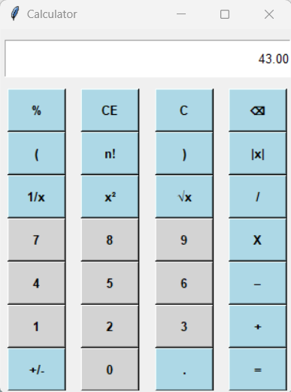
Demonstration:

Slide 9
Usage of Calculator :
Solving Complex Equation
Exponential
Standard Equation
Scientific Computation
Trigonometry Problem

Slide 10
Future Enhancement:
Possible Improvement
Next
Step
Better UI
Adding Menu
Put better Symbols
Scientific Functionality
Trigonometry calculation
Programming Ability
Improve UI

Slide 11




Conclusion:
Lesson Learned:
Improve Coding Skill
Better understanding of how to handle functionality
Acknowledgement:
Want to say Thank u to my mentor for provide better guidance.
Summary:
The Basic and advanced Functionality perform by user.

Slide 12
Thank u….
I am Happy to answer all your questions.

